Slide 1

Chapter 8
Data Abstractions

Slide 2

Chapter 8: Data Abstractions
8.1 Data Structure Fundamentals
8.2 Implementing Data Structures
8.3 A Short Case Study
8.4 Customized Data Types
8.5 Classes and Objects
8.6 Pointers in Machine Language

Slide 3
Basic data structures
Homogeneous array
List
  Stack
  Queue
Tree

Slide 4
Terminology for lists
List = collection of data whose entries are arranged sequentially
Head = beginning
Tail = end

Slide 5
Terminology for stacks
Stack = a list in which entries are removed and inserted only at the head
LIFO = last-in-first-out
Top = head of list
Bottom or base = tail of list
Pop = remove entry from the top
Push = insert entry at the top

Slide 6
Terminology for queues
Queue = a list in which entries are removed at the head and are inserted at the tail
FIFO = first-in-first-out

Slide 7
Terminology for a tree
Tree = a collection of data whose entries have a hierarchical organization
Node = an entry in a tree
Binary tree = tree in which every node has at most two children
Depth = number of nodes in longest path from root to leaf

Slide 8
Terminology for a tree (continued)
Root node = the node at the top
Terminal or leaf node = a node at the bottom
Parent of a node = the node immediately above the specified node
Child of a node = a node immediately below the specified node
Ancestor = parent, parent of parent, etc.
Descendent = child, child of child, etc.
Siblings = nodes sharing a common parent

Slide 9
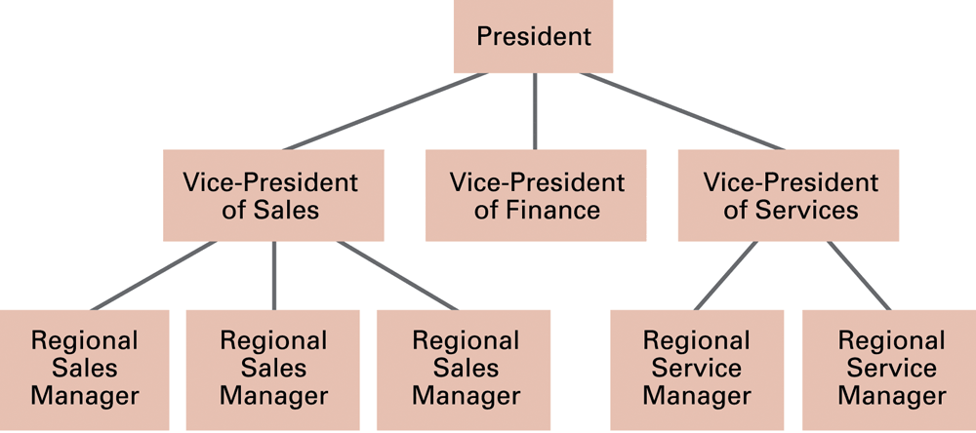
Figure 8.1 An example of an organization chart

Slide 10
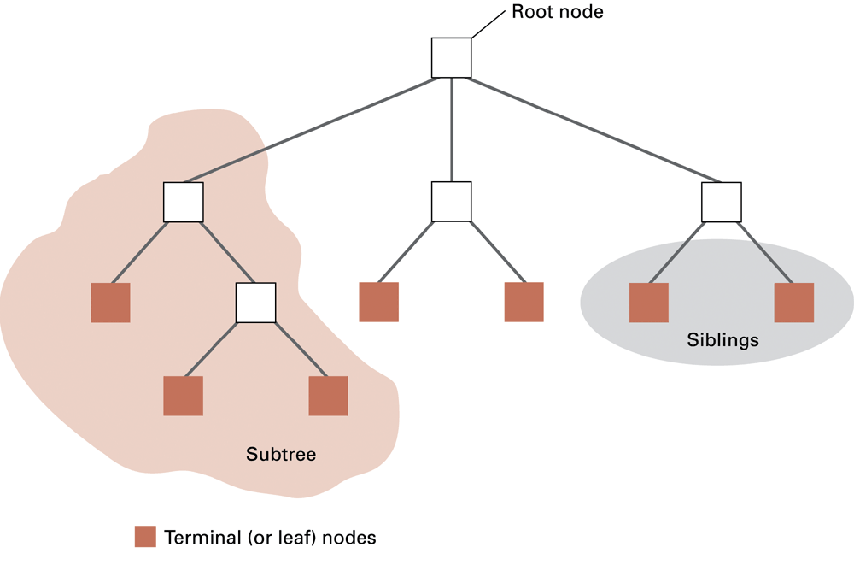
Figure 8.2 Tree terminology

Slide 11
Nature of data structures
Static: size of data structure does not change
Dynamic: size of data structure can change

Slide 12
Storing homogeneous arrays
Requires enough contiguous memory to hold all data
Two dimensional arrays
  Row-major order: each row is stored together
    Address polynomial: A[r,c] = (r-1)(# columns) + (c-1)
  Column-major order: each column is stored together

Slide 13
Storing lists
Contiguous list = list stored in a homogeneous array
Linked list = list in which each node points to the next one
  Head pointer = pointer to first entry in list
  NIL pointer = non-pointer value used to indicate end of list

Slide 14
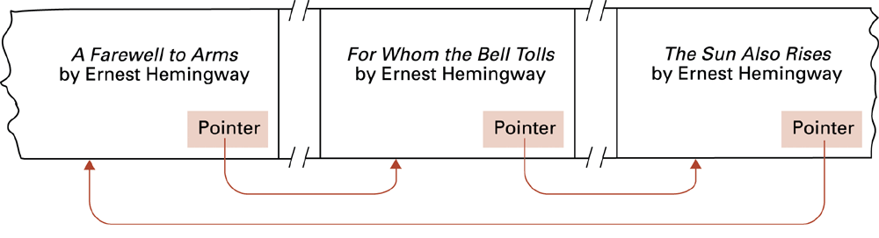
Figure 8.3 Novels arranged by title but linked according to authorship

Slide 15
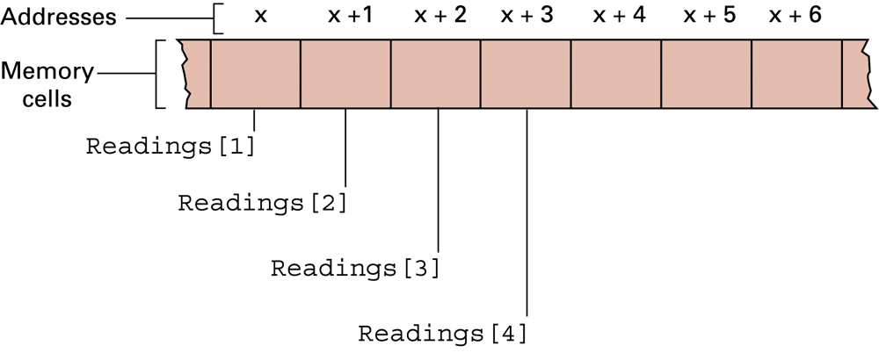
Figure 8.4 The array of temperature readings stored in memory starting at address x

Slide 16
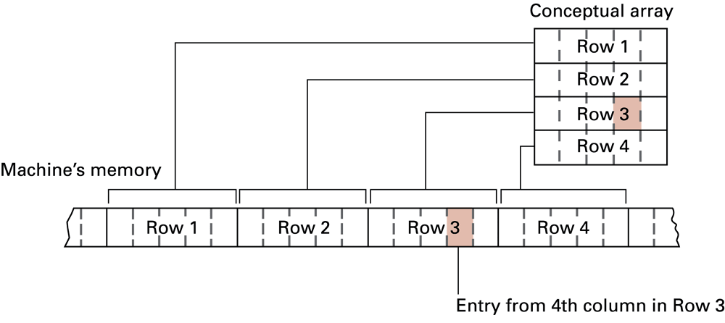
Figure 8.5 A two-dimensional array with four rows and five columns stored in row major order

Slide 17
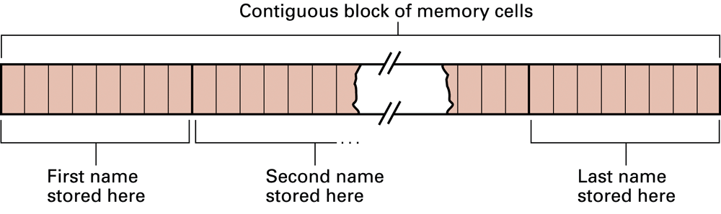
Figure 8.6 Names stored in memory as a contiguous list

Slide 18
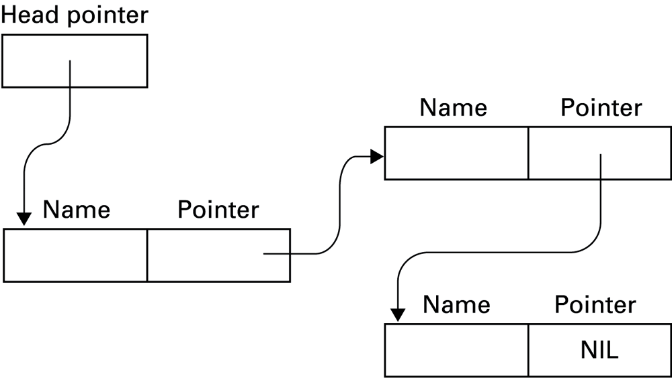
Figure 8.7 The structure of a linked list

Slide 19
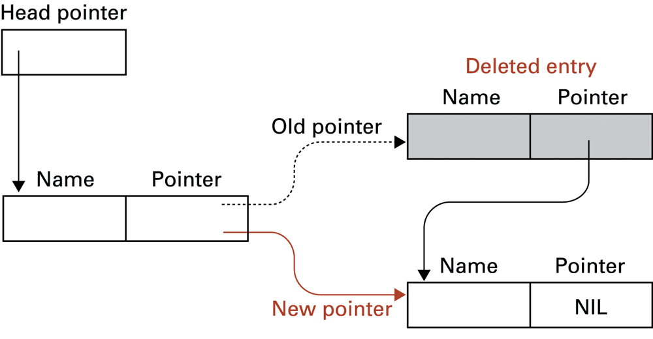
Figure 8.8 Deleting an entry from a linked list

Slide 20
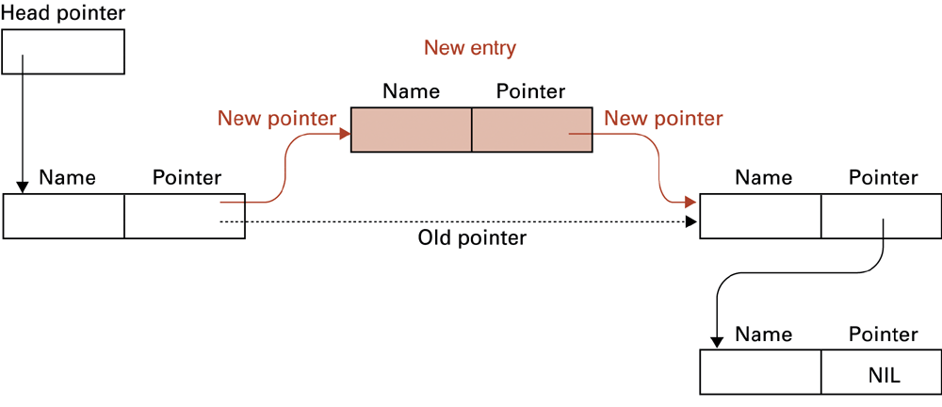
Figure 8.9 Inserting an entry into a linked list

Slide 21
Storing stacks and queues
Can use same mechanisms as for lists
Circular queue = homogeneous array where the first array entry is treated as immediately following the last array entry
  Prevents a queue from crawling out of its allotted storage space

Slide 22
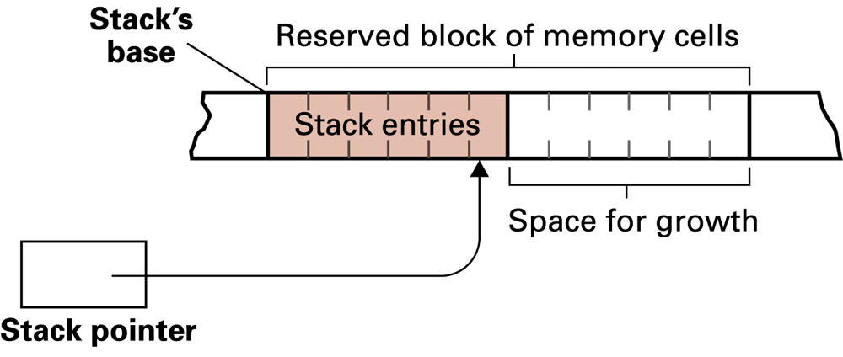
Figure 8.10 A stack in memory

Slide 23
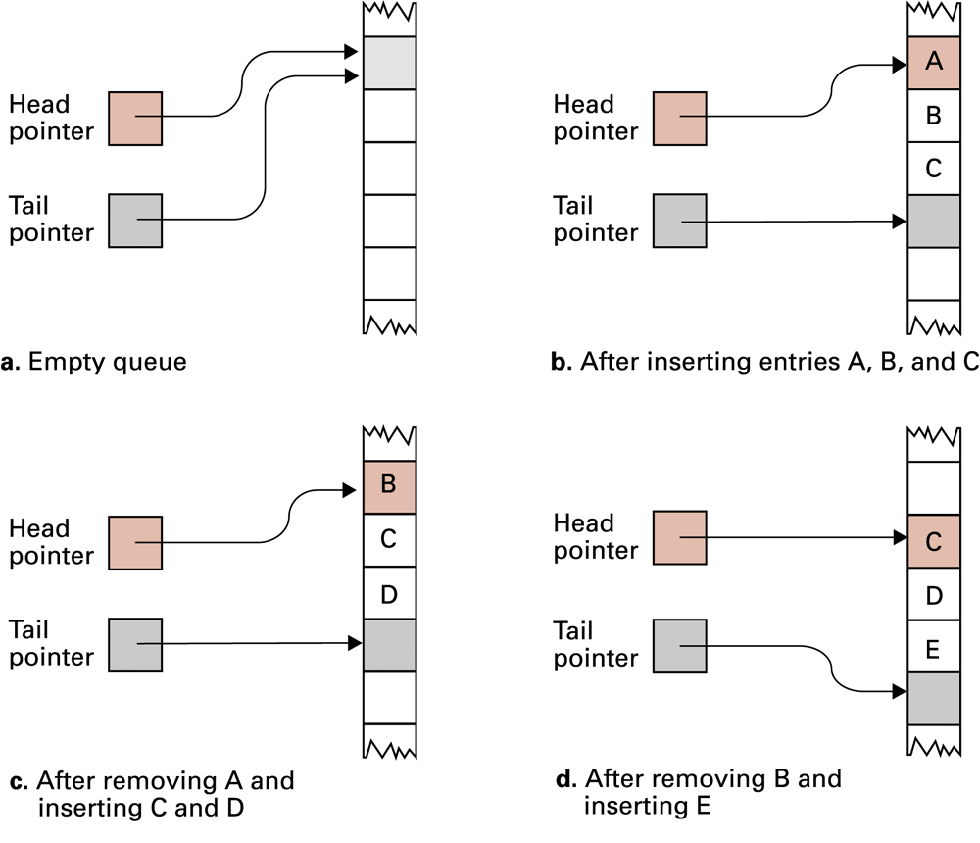
Figure 8.11 A queue implementation with head and tail pointers. Note how the queue crawls through memory as entries are inserted and removed.

Slide 24
Storing a binary tree
Linked structure
  Each node = data cell + two child pointers
  Accessed through a pointer to root node
Mapped to a contiguous array
  A[1] = root node
  A[2],A[3] = children of A[1]
  A[4],A[5],A[6],A[7] = children of A[2] and A[3]
  …

Slide 25
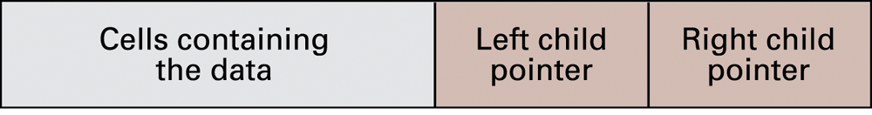
Figure 8.12 The structure of a node in a binary tree

Slide 26
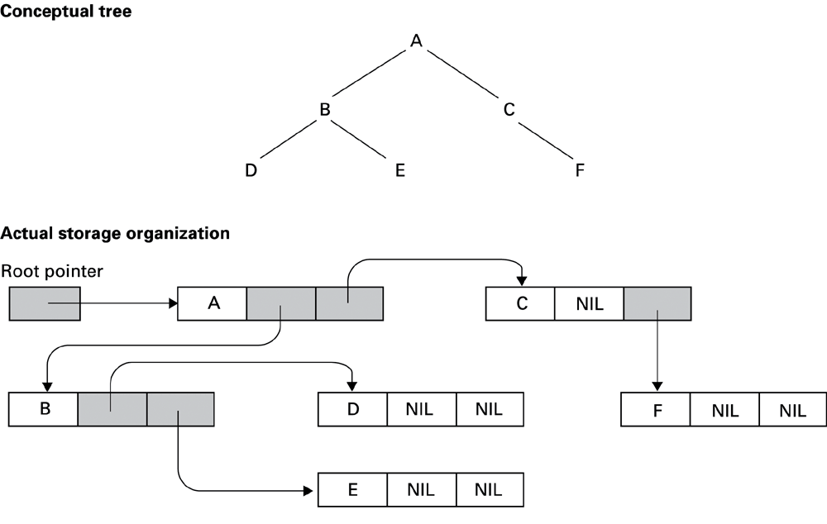
Figure 8.13 The conceptual and actual organization of a binary tree using a linked storage system

Slide 27
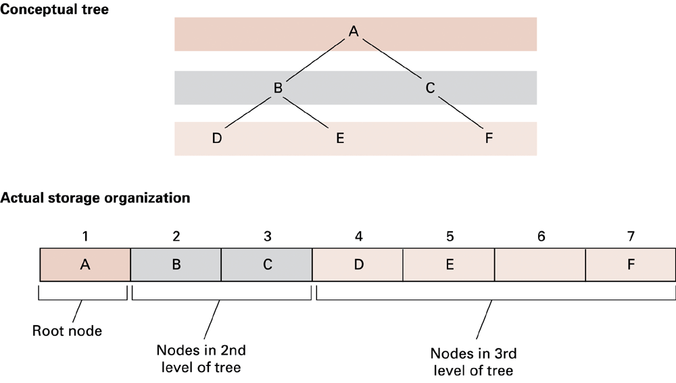
Figure 8.14 A tree stored without pointers

Slide 28
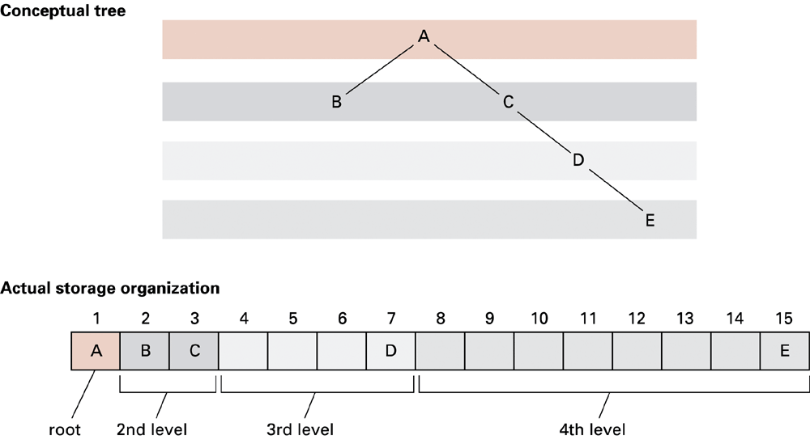
Figure 8.15 A sparse, unbalanced tree shown in its conceptual form and as it would be stored without pointers

Slide 29
Manipulating data structures
Ideally, a data structure should be manipulated solely by pre-defined procedures.
  Example: A stack typically needs at least push and pop procedures.
  The data structure along with these procedures constitutes a complete abstract tool.

Slide 30
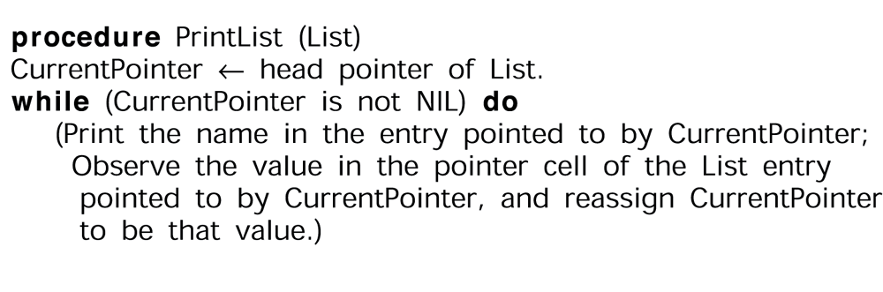
Figure 8.16 A procedure for printing a linked list

Slide 31
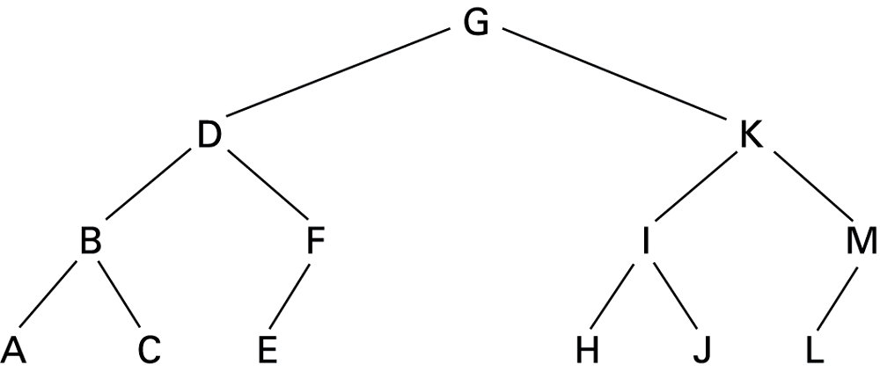
Figure 8.17 The letters A through M arranged in an ordered tree

Slide 32
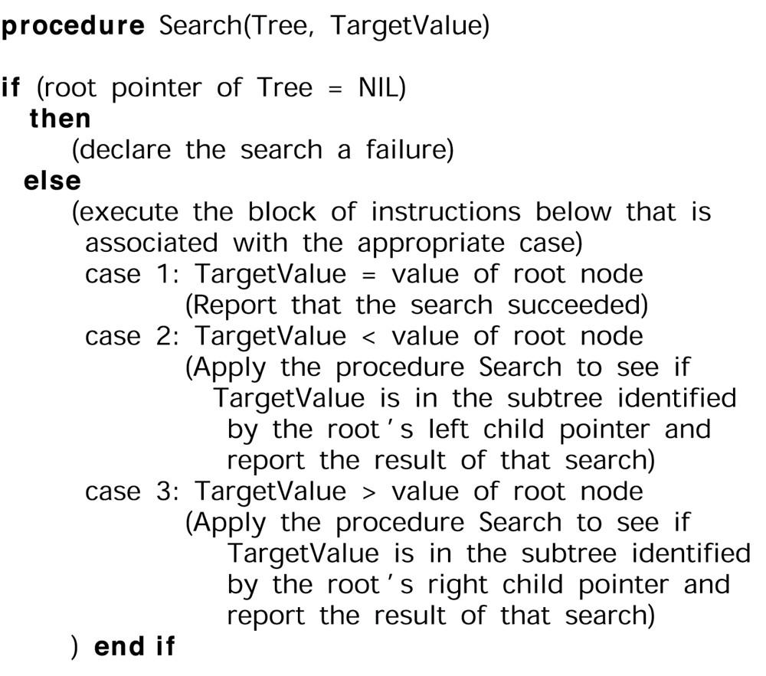
Figure 8.18 The binary search as it would appear if the list were implemented as a linked binary tree

Slide 33
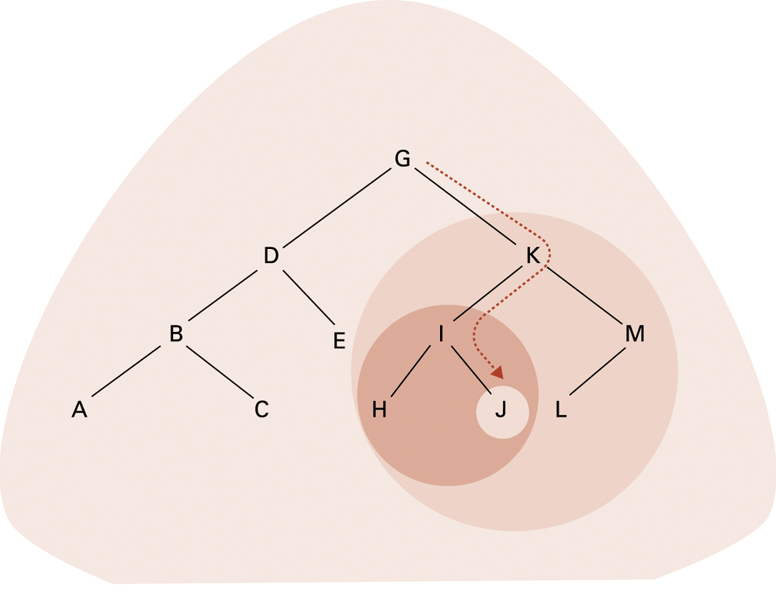
Figure 8.19 The successively smaller trees considered by the procedure in Figure 8.18 when searching for the letter J

Slide 34
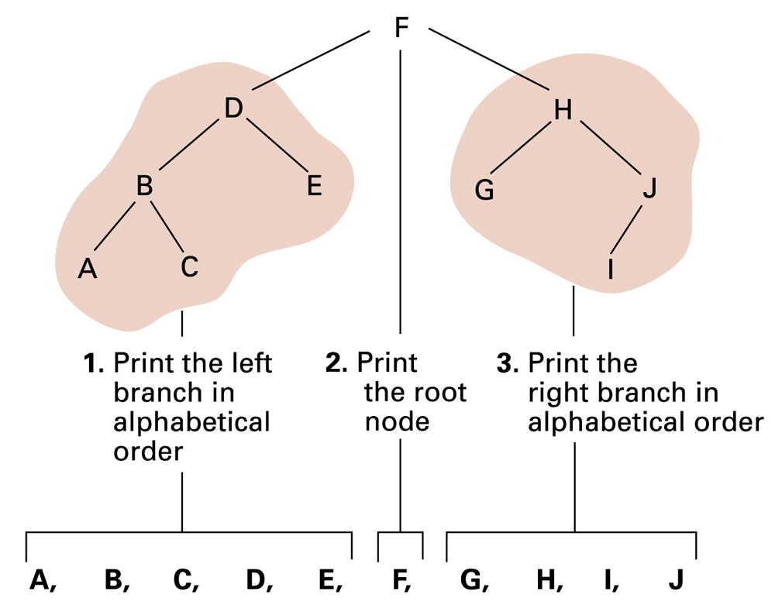
Figure 8.20 Printing a search tree in alphabetical order

Slide 35
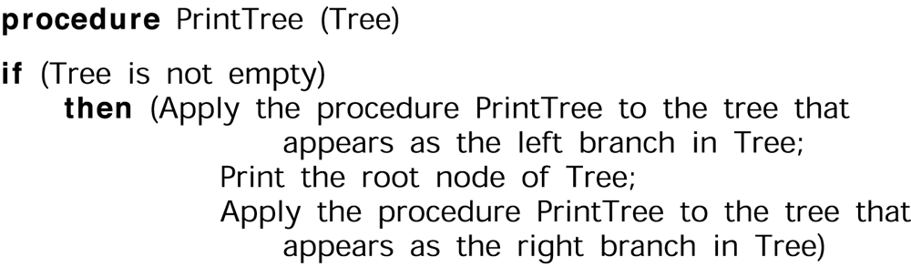
Figure 8.21 A procedure for printing the data in a binary tree

Slide 36
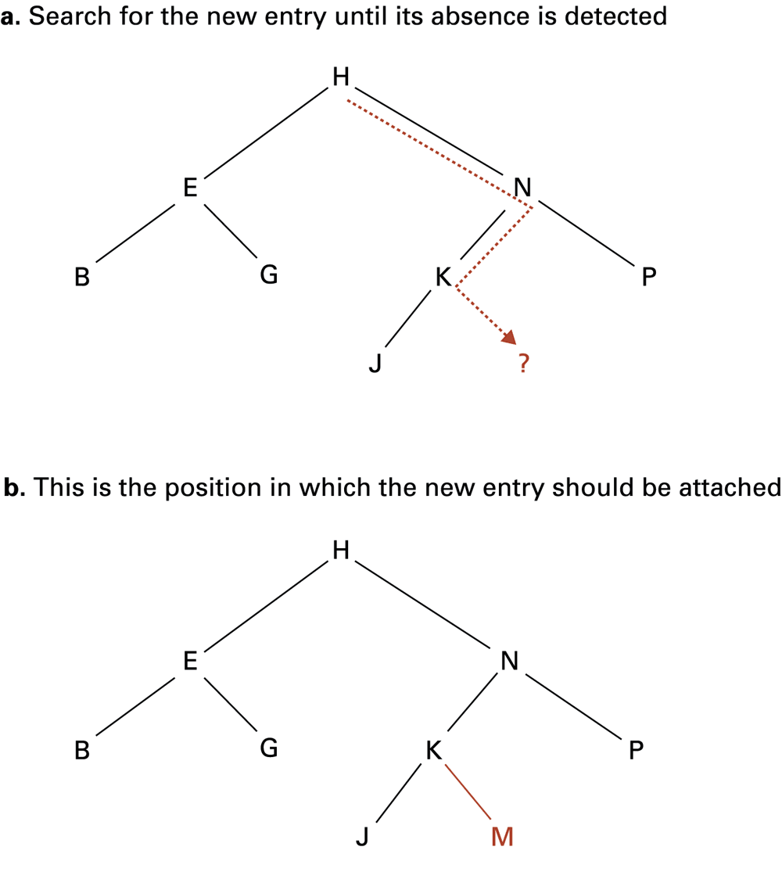
Figure 8.22 Inserting the entry
M into the list B, E, G, H, J, K, N, P stored as a tree

Slide 37
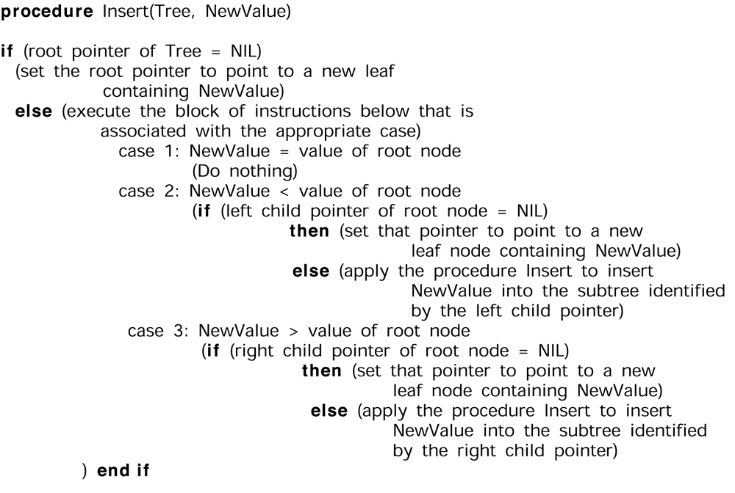
Figure 8.23 A procedure for inserting a new entry in a list stored as a binary tree

Slide 38
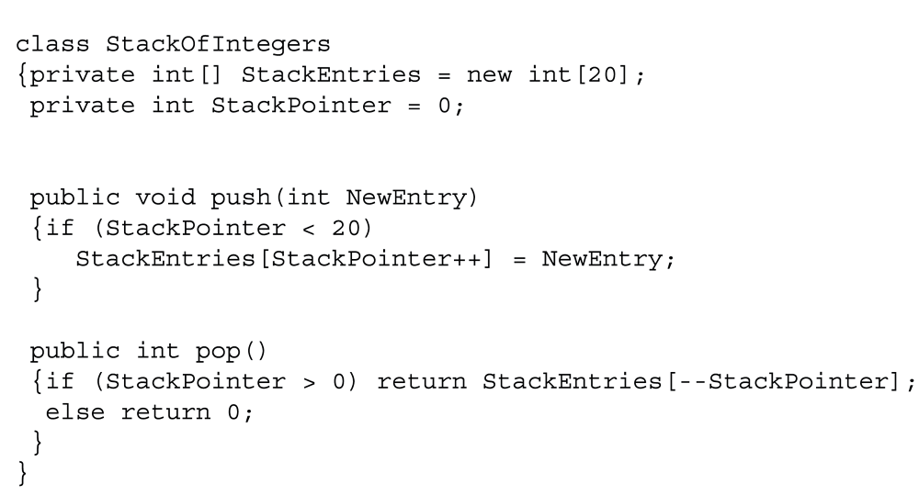
Figure 8.24 A stack of integers implemented in Java and C#

Slide 39
Customized data types
User-defined data type = template for a heterogeneous structure
Abstract data type = user-defined data type with methods for access and manipulation
Class = abstract data type with extra features
  Characteristics can be inherited
  Contents can be encapsulated
  Constructor methods to initialize new objects

Slide 40
Pointers in machine language
Immediate addressing: instruction contains the data to be accessed
Direct addressing: instruction contains the address of the data to be accessed
Indirect addressing: instruction contains the location of the address of the data to be accessed

Slide 41
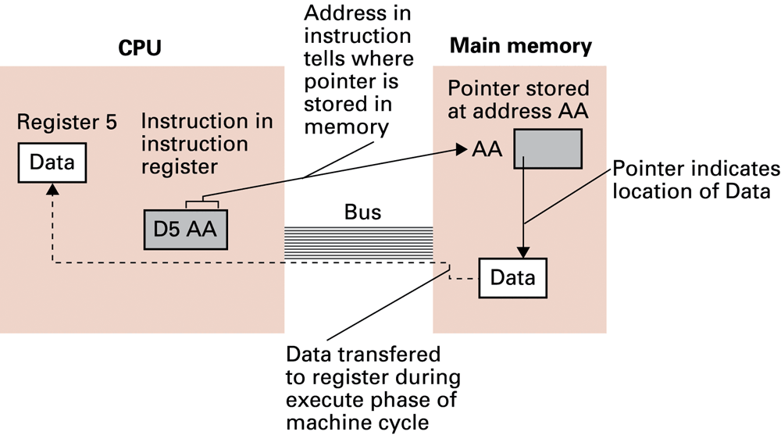
Figure 8.25 Our first attempt at expanding the machine language in Appendix C to take advantage of pointers

Slide 42
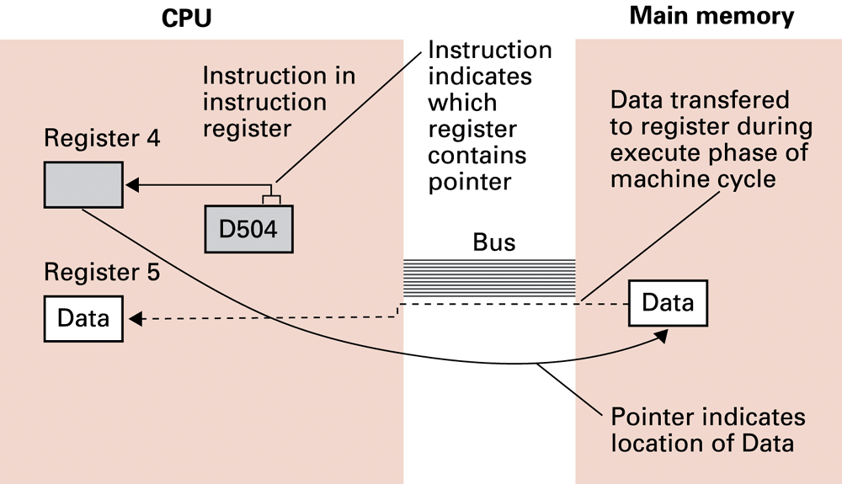
Figure 8.26 Loading a register from a memory cell that is located by means of a pointer stored in a register

